Slide 1
Naïve Bayes’ Classifier

Slide 2
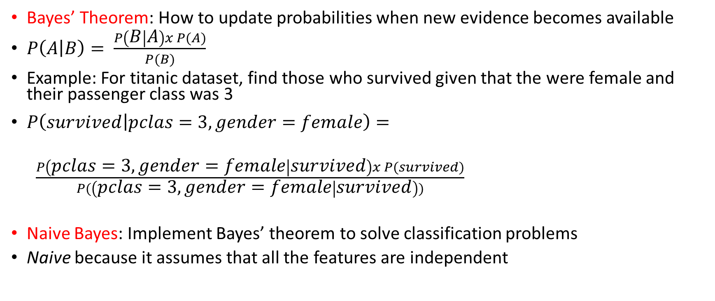
Bayes Theorem and Naïve Bayes Classifier
Bayes’ Theorem: How to update probabilities when new evidence becomes available
$P\left(A | B\right)= \frac{P\left(B | A\right)x P(A)}{P(B)}$
Example: For titanic dataset, find those who survived given that the were female and their passenger class was 3
$P\left(survived | pclas=3, gender=female\right)=$
$\frac{P\left(pclas=3, gender=female | survived\right)x P(survived)}{P(\left(pclas=3, gender=female | survived\right))}$
Naive Bayes: Implement Bayes’ theorem to solve classification problems
Naive because it assumes that all the features are independent

Slide 3

Naïve Bayes – Customer Example
Purchase
Id | Newsletter Subscriber? | Social Media Follower? | Visited Website? | Purchase?
1 | 0 | 1 | 0 | 1
2 | 1 | 0 | 1 | 0
3 | 1 | 1 | 0 | 1
4 | 0 | 0 | 0 | 0
5 | 1 | 0 | 0 | 0
6 | 1 | 1 | 1 | 1
7 | 1 | 0 | 1 | 0
8 | 0 | 1 | 1 | 1
9 | 1 | 0 | 1 | 1
10 | 1 | 1 | 0 | 0
11 | 0 | 1 | 1 | ?
Conditional probabilities
P(News | Purchase) = $\frac{3}{5}=$ 60%
P( No News | Purchase) = $\frac{2}{5}=$ 40%
P(News | No Purchase) = $\frac{4}{5}=$ 80%
P( No News | No Purchase) = $\frac{1}{5}=$ 20%
Similarly: For Social Media and Website
 | 1 | 0
1 | 3 | 4
0 | 2 | 1
Newsletter
 | 1 | 0
1 | 4 | 1
0 | 1 | 4
Social Media
 | 1 | 0
1 | 3 | 2
0 | 2 | 3
Website
Overall
50% | 50%

Slide 4
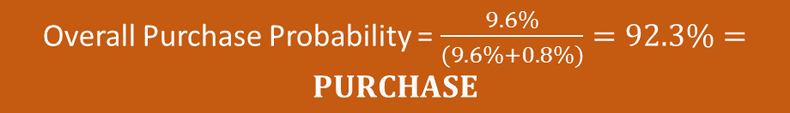
Naïve Bayes
Newsletter Subscriber? | Social Media Follower? | Visited Website?
Predict for:
For these, we need to find:
0 | 1 | 1
P (News | Purchase) | 60%
P (No News | Purchase) | 40%
P (Social | Purchase) | 80%
P (No Social | Purchase) | 20%
P (Website | Purchase) | 60%
P (No Website | Purchase) | 40%
P (News | No Purchase) | 80%
P (No News | No Purchase) | 20%
P (Social | No Purchase) | 20%
P (No Social| No Purchase) | 80%
P (Website | No Purchase) | 40%
P (No Website| No Purchase) | 60%
P (Purchase) | 50%
P (No Purchase) | 50%
Probability given Purchase = 1
Probability given Purchase = 0
P (No News | Purchase)
x
P (SM | Purchase)
x
P (Website | Purchase)
x
P (Purchase)
P (No News | No Purchase)
x
P (SM | No Purchase)
x
P (Website | No Purchase)
x
P (No Purchase)
40% x 80% x 60% x 50% = 9.60%
20% x 20% x 40% x 50% = 0.80%
Overall Purchase Probability = $\frac{9.6\%}{(9.6\%+0.8\%)}=92.3\%=PURCHASE$

Slide 5
Naïve Bayes Types
Gaussian Naive Bayes: Gaussian (normal) distribution (Example: Height, Weight, etc); less effective with categorical data
Multinomial Naive Bayes: Suitable for discrete data, often used in text classification with word frequencies
Bernoulli Naive Bayes: Designed for binary/boolean features, useful for text classification with binary attributes
Complement Naive Bayes: For imbalanced datasets
Text Classification: Text classification tasks such as spam detection, sentiment analysis, and document categorization

Slide 6
Naïve Bayes
C:\code\Data Analytics\naive_bayes_diabetes.py
Confusion matrix output
[[79 20]
[16 39]]
79 = TN = Model correctly predicted Outcome = 0
20 = FP = Model incorrectly predicted Outcome = 1, Actual Outcome = 0
16 = FN = Model incorrectly predicted Outcome = 0, Actual Outcome = 1
39 = TP = Model correctly predicted Outcome = 1
naive_bayes_titanic.py

Slide 7
Factor Analysis/Dimensionality Reduction

Slide 8
Factor Analysis/Dimensionality Reduction
Reduce the number of features without losing much information
Example: Credit card fraud – Day of the week, Time, Place, Reason, Amount, Online/Offline, …?
Data Summarization or Data Reduction technique
Also called Dimensionality reduction
One implementation: Principal Component Analysis (PCA), see C:\lectures\CDAC\DAI\PCA.docx
New components replace factors, so transformation technique, not selection technique
Component ≠ Factor/Feature
Analysis of relationships between Factors/Features -> Components

Slide 9
Finding Components in PCA
Dataset C:\code\Data Analytics\pca_student_test_scores.csv
Scatterplots: pca_basics_student_test_scores.py (Output on the next slide)
Observation: Only Spelling-Vocabulary and Multiplication-Geometry are correlated
Student exercise : Create correlation plots among Spelling-Vocabulary and Multiplication-Geometry : pca_basics_student_test_scores_regression.py (Output on slide after next)

Slide 10
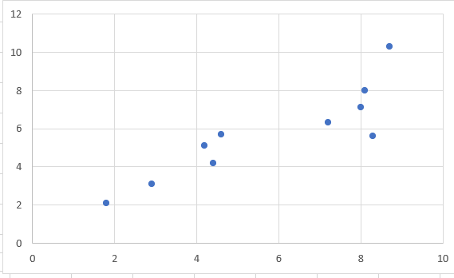
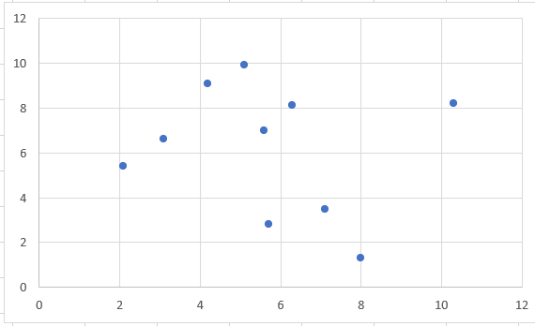
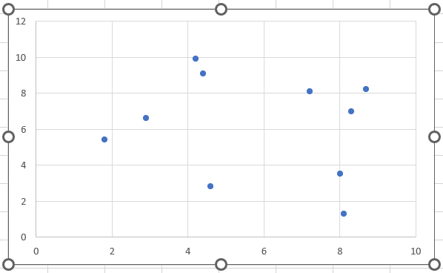
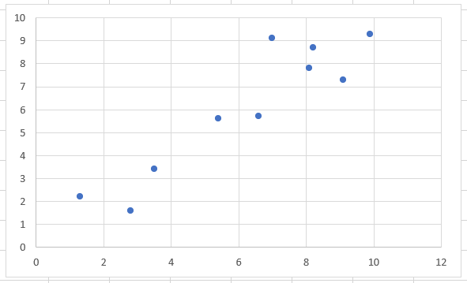
Pairs of Dimensions
Spelling (X) - Vocabulary (Y) Vocabulary (X) - Multiplication (Y)
Spelling (X) - Multiplication (Y) Multiplication (X) - Geometry (Y)

Slide 11
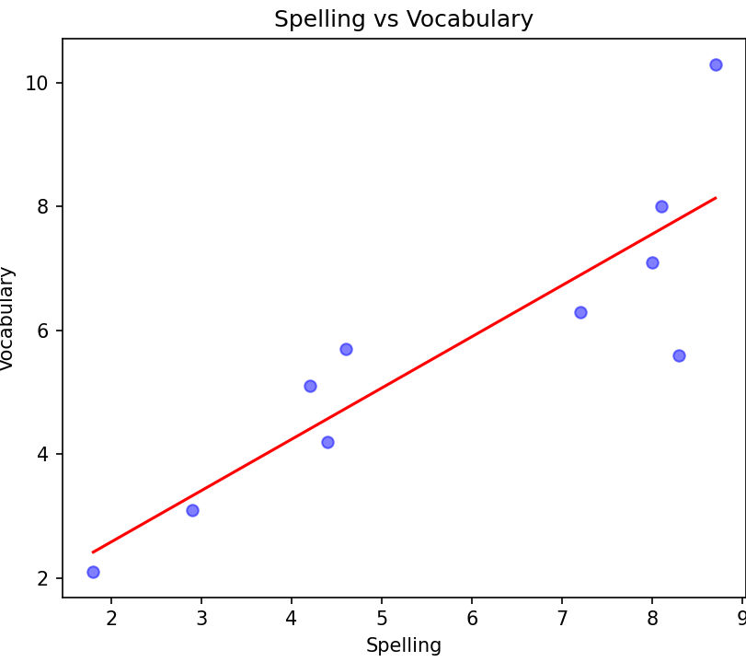
From Correlation to Components
PCA: Reduce multiple features into a component (e.g. here, two features to one component)
Step 1: Create a scatter plot of x and y and find its center
Step 2: Draw a line through the center in such a way that it will capture most of the variance
Component
Consider this data point: Spelling (x) = 8.3, Vocabulary (y) = 5.6

Slide 12

How to measure a Component?
Weight: Position of a feature relative to the regression line
Weight = Component’s value for each original data point
Example
Example:
x = 8.3,y = 5.6
Calculating weight by using the Pythagorean theorem:
$d= √({(x2−x1)}^{2}$+ $({(y2−y1)}^{2}$)
$d= √({(8.3−0)}^{2}$+ $({(5.6−0}^{2}$) )
$d= √($68.89 + $31.36$)
$$d=10=Weight of this point$$
Weighting = 10

Slide 13
Components for Spelling-Vocabulary and Multiplication-Geometry
StudentID | Spelling (S) | Vocabulary (V) | Component1 (S-V) | Multiplication (M) | Geometry (G) | Component2 (M-G)
1 | 1.8 | 2.1 | 2.8 | 5.4 | 5.6 | 7.8
2 | 2.9 | 3.1 | 4.3 | 6.6 | 5.7 | 8.7
3 | 4.6 | 5.7 | 7.3 | 2.8 | 1.6 | 3.2
4 | 8.0 | 7.1 | 10.7 | 3.5 | 3.4 | 4.9
5 | 8.1 | 8.0 | 11.4 | 1.3 | 2.2 | 2.6
6 | 8.3 | 5.6 | 10.0 | 7.0 | 9.1 | 11.5
7 | 4.4 | 4.2 | 6.1 | 9.1 | 7.3 | 11.6
8 | 7.2 | 6.3 | 9.6 | 8.1 | 7.8 | 11.3
9 | 4.2 | 5.1 | 6.6 | 9.9 | 9.3 | 13.6
10 | 8.7 | 10.3 | 13.5 | 8.2 | 8.7 | 12.0

Slide 14
Interpreting Components
Loadings/Coefficients: Explain the relationship between each component and the original dimensions (denoted by Y)
Calculations beyond the scope, but final result in our example:
Coefficient of Component1 (S-V) : Y = (0.72 . X1) + (0.69 . X2) + (-0.02 . X3) + (0.03 . X4)
Coefficient of Component2 (M-G): Y = (0.004 . X1) + (0.001 . X2) + (0.68 . X3) + (0.72 . X4)
How to interpret? See next slides

Slide 15
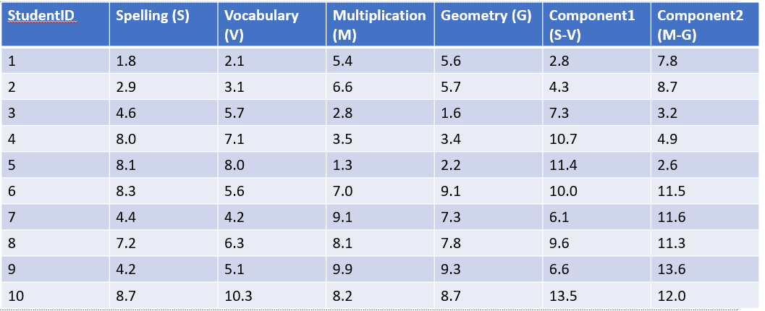
Interpreting Components
X1
X2
X3
X4
Y
High coefficient on X1 (Spelling) and X2 (Vocabulary) – so we can interpret component1 as Language
Y = (0.72 . X1) + (0.69 . X2) + (-0.02 . X3) + (0.03 . X4)

Slide 16
Interpreting Components
X1
X2
X3
X4
Y
High coefficient on X3 (Multiplication) and X4 (Geometry) – so we can interpret component2 as Maths
Y = (0.004 . X1) + (0.001 . X2) + (0.68 . X3) + (0.72 . X4)

Slide 17
Final Result
StudentID | Language | Maths
1 | 2.8 | 7.8
2 | 4.3 | 8.7
3 | 7.3 | 3.2
4 | 10.7 | 4.9
5 | 11.4 | 2.6
6 | 10.0 | 11.5
7 | 6.1 | 11.6
8 | 9.6 | 11.3
9 | 6.6 | 13.6
10 | 13.5 | 12.0

